Slide 1


Mobile application with
Launching YAQS project !

Slide 2

Meetup menu
Introduction
Mobile development
Qt overview Focus on QtQuick
Launching YAQS Debrief and apéro

Slide 3
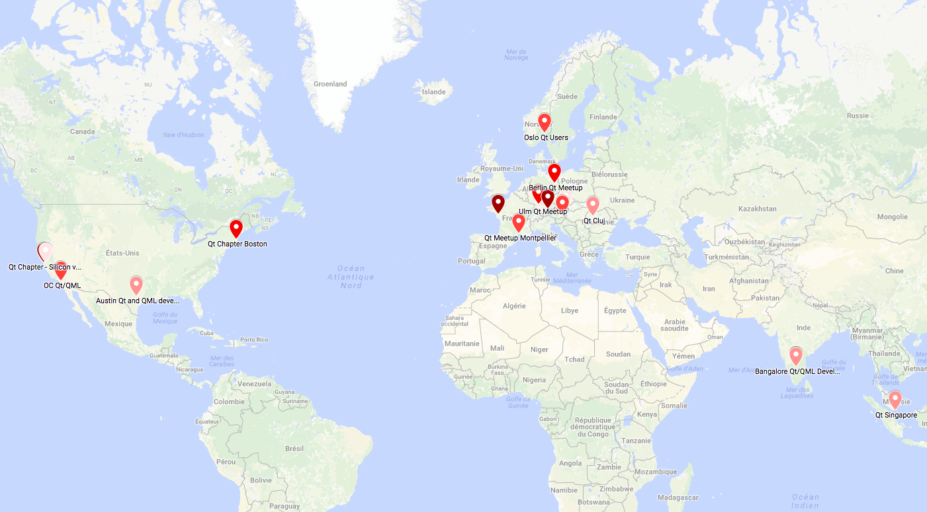
The Nantes meetup
15 meetups about Qt in the world…

Slide 4
Untill now…
Menu
Goals
Presentation (30mn)
Tour de table (15mn)
Workshop or project (1h)
Debrief (15mn)
Discover /Promote Qt
Get to know each others / create a community
Learn / improve ourselves

Slide 5
Not easy to satisfy everyones expectations !

Slide 6
Proposal of a new formula !

Slide 7
but keeping what matters !

Slide 8
The new meetup formula

Slide 9
The YAQS project (Yet Another Qar Simulator)

Slide 10
The YAQS project – modules description
Navigation
Control panel
I/O
Instruments
panel
3D Visual
System
Systems
Sound environment

Slide 11
The YAQS project - architecture
Navigation
Control panel
I/O
Instruments
panel
Data
3D Visual
System
Systems
Sound environment

Slide 12
The YAQS project - principles
Data
Module 1
1 - Read
2 - Process
…
3 - Write
Module n

